Slide 2
Course project – JPEG encoder
JPEG encoder hardware implementation

Slide 3

Course project
Complete Digital Camera model
Imager chip – stub, behavioral verilog
JPEG encoder – RTL, synthesizable verilog
Flash disk – stub, behavioral verilog
Input : picture.bmp - picture dimension is variable
Output : picture.jpg – valid compressed picture file, readable by any photo software, ie. iexplorer.

Slide 4
Project diagram
Verilog top level
imager
JPEG encoder system
flash disk
shoot task

Slide 5
Imager
In real life – CMOS sensor array, able to capture a color image.
Usually can output video in two formats, YUV or RGB.
RGB – Red Green Blue, color is separated into three basic colors by means of optical filters.
YUV – Luminance (brightness), Cb, Cr, yet another representation of color space.

Slide 6
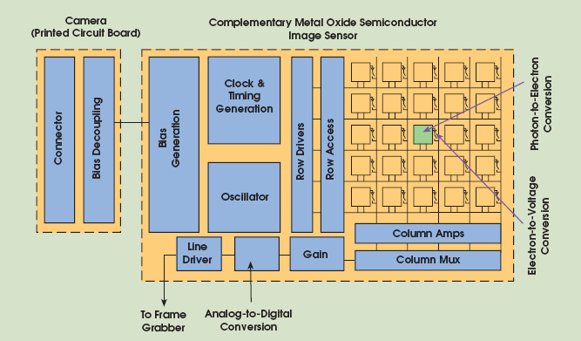
CMOS sensor

Slide 7
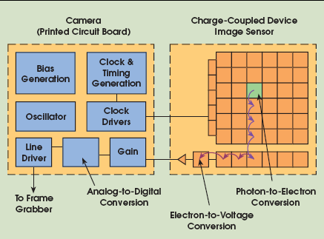
CCD sensor

Slide 8
Imager I/O
pin name | width | direction | description
RST | 1 | input | reset the device, active high
CLK_IN | 1 | input | clock input. 12Mhz typical.
HD | 1 | output | synch for horizontal data
VD | 1 | output | synch for vertical data
PXQ | 1 | output | pixel qualifier
DOUT | 8 | output | pixels output data
SHOOT | 1 | input | instruct the imager to take a new picture
VID_TYPE | 1 | input | 1 for RGB, 0 for YUV.

Slide 9
Imager stab characteristic
Behavioral verilog (like test bench)
Able to read preformatted files (representing bit map pictures) from the disk, and drive them on an output bus in a predefined order.
Output will be driven in two formats RGB/YUV. Based on vid_type input pin.
On every pulse on the SHOOT input a new picture will be transferred.
Output repeats until the next SHOOT pulse.

Slide 10
bin2vhex utility
A tiny C utility bin2vhex should be constructed.
It reads the <your picture>.bmp
It outputs <your picture>_i.hex
Example :
bin2vhex lena.bmp <CR> writing … lena_0.hex lena_1.hex lena_n.hex
Those files will be read by the imager stub, one by one.
$readmemh(“lena_0.hex”, pic_mem);

Slide 11
bmp2vhex utility
File format
Each line contains 32bits in hex 8 digits format w/o 0x prefix.
12abffff // line 0 ffff44dd // line 1
In case where bmp file size (bytes) % 4 is not zero, a known padding bytes should be added so that stub can detect it and stop reading.
In short, this util converts binary file to verilog hex 32bits per line.

Slide 12
Video output format
Video bit stream will be 8 bits width.
On every posedge of the clock a new data pixel should be introduce qualified with the PXQ output
The first pixel of a new line should be tagged by HD signal.
The first pixel of the image should be tagged by the VD signal.
Imager should communicate to the encoder the image dimension, this will be done on the first 4 cycles after SHOOT is received where PXQ is low and HD and VD are high, in the following order (Xlow, Xhigh, Ylow, Yhigh).

Slide 13
Video output format (1)
Imager should communicate to the encoder the image name, this will be done on the next 8 cycles after the image dimension transfer.
So we will support up to 8 characters image name.

Slide 14
Video output format
Bmp file assume to hold data in RGB format.
Based on VID_TYPE, the imager shall convert the color space to YUV.
VID_TYPE == 1 : no conversion
VID_TYPE == 0 : conversion to YUV
Order of data on the wire:
RGB : Red first, Green second, Blue last and repeat.
YUV : Luminance first Cb second, Cr last and repeat.
For more details on imagers chips check the following pdf doc5446.pdf

Slide 15
Imager timing diagram
shoot
1 - one or more cycles
vd
1
hd
1
pxq
1- data valid
do[7:0]
Xlow
Xhigh
Ylow
Yhigh
R
G
video_type
1 - RGB
-
-
A shot followed by image dimension transfer
-
-

Slide 16
Imager timing diagram
shoot
vd
1
hd
1
pxq
1- data valid
do[7:0]
R
G
G
R
G
G
video_type
1 - RGB
-
-
Start of image followed by cyclic RGB
-
-

Slide 17
Imager timing diagram
shoot
vd
1
hd
1
pxq
1- data valid
do[7:0]
Y
Cb
Cr
Y
Cb
Cr
video_type
0 - YUV
-
-
Start of image followed by cyclic YUV
-
-

Slide 18
Imager timing diagram
shoot
vd
hd
1
pxq
1- data valid
do[7:0]
G
G
R
G
G
R
G
G
video_type
1 - RGB
-
-
New line
-
-

Slide 19
Imager timing diagram
shoot
vd
hd
pxq
1- data valid
do[7:0]
G
G
R
G
G
video_type
1 - RGB
-
-
-
End of image
-

Slide 20
Flash Disk
Input/output device
When serve as an input : can hold files (as operating system files) that holds your constants.
When serve as an output : receives a “file name” and an input stream of data and write them to the disk in 32bits hex format.

Slide 21
Flash disk I/O
pin name | width | direction | description
RST | 1 | input | reset the device, active high
CLK_IN | 1 | input | clock input. Up to 100Mhz
M_CMD | 2 | input | master command, 00 for NOP, 01 for READ, 10 for WRITE
D_QUAL | 1 | input | 1 - for file name, effective in read and write. 0 for data, effective in write.
D_INOUT | 32 | inout | input/output data
M_BE | 4 | input | byte qualifier for write data (used for last DWORD of file)
S_BE | 4 | output | byte qualifier for read data (used for last DWORD of file)
ERR | 1 | output | error indication, trasaction can not be performed, for instance in read, file does not exist.
M_HALT | 1 | output | by this signal master inserts nop on the line, halt generally invalidate the data of the sender. Data is considered transferred only when both master and slave HALT signal is low and a valid command is on the line.
S_HALT | 1 | input | see above
M_EOF | 1 | input | indication that current transaction is last for the current open file
S_EOF | 1 | output | indication that current transaction is last for the current open file

Slide 22
Flash disk requirements
Supports two threads, 1 read, 1 write.
Write/Reads files to/from the OS using “file_name” given at the beginning of the transaction.
File will be opened for write via system task $fopen, and for read via $readmemh.
File will be written in 32 bits hex format via system task $fdisplay or $fwrite;

Slide 23
Flash disk requirements
EOF for written files will be tagged on disk by XX byte.
In case where file size (bytes) % 4 !=0 ➔ last line will be 1234XXXX
In case where file size (bytes) % 4 == 0 ➔ last line will be XXXXXXXX
The same convention will be valid for files read from disk, however, files read from disk are assumed to have n x 256 lines.

Slide 24
vhex2bin utility
A tiny vhex2bin C utility shall be constructed.
It shall read verilog hex files written by the flash disk and converted them to binary file.
Example :
vhex2bin lena.jpg.hex <CR> writing … lena.jpg

Slide 25
vhex2bin utility
File format
Each line contains 32bits in hex 8 digits format w/o 0x prefix.
12abffff // line 0 ffff44dd // line 1
In case where hex file size (bytes) % 4 is not zero, file assumed to be XX padded, utility will rely on this to close the binary file.
In short, this util converts verilog hex 32bits per line file to binary file.

Slide 26
Flash disk - write
cmd
write
d_qual
File name transfer
File data transfer
d_inout[31:0]
a.jpg
File words …
m_be[3:0]
4’b1111
s_be[3:0]
What is the resulting file size ?
m_halt
s_halt
m_eof
EOF
s_eof
Start of write
err

Slide 27
Write with master halt
cmd
write
File name transfer
File data transfer
d_qual
dont care
a.jpg
File words …
d_inout[31:0]
dont care
m_be[3:0]
4’b1111
dont care
s_be[3:0]
m_halt
halt
s_halt
m_eof
EOF
s_eof
To stop temporary, one assert the halt!
err
What is the resulting file size ?

Slide 28
Write with no EOF yet
cmd
write
nop
File name transfer
File data transfer
d_qual
don’t care
a.jpg
File words …
d_inout[31:0]
don’t care
m_be[3:0]
4’b1111
don’t care
s_be[3:0]
m_halt
s_halt
To stop for unknown cycles, Master drop the command to nop
m_eof
What is the resulting file size ? No end yet
s_eof
err

Slide 29
Write with slave halt
cmd
write
d_qual
File name transfer
File data transfer
d_inout[31:0]
a.jpg
File words …
m_be[3:0]
4’b1111
s_be[3:0]
m_halt
s_halt
halt
m_eof
Master stretch the data for one additional cycle
s_eof
Halt inserted by slave
err

Slide 30
Write with slave halt
cmd
write
nop
File name transfer
File data transfer
d_qual
don’t care
a.jpg
File words …
d_inout[31:0]
don’t care
m_be[3:0]
4’b1111
don’t care
s_be[3:0]
m_halt
s_halt
halt
m_eof
s_eof
Halt inserted by slave
err

Slide 31
Write followed by read
cmd
write
read
d_qual
File name transfer
File data transfer
File name transfer
File data transfer
d_inout[31:0]
a.jpg
File words …
swap.d
File words …
m_be[3:0]
4’b1111
don’t care
s_be[3:0]
4’b1111
m_halt
s_halt
Bus turn over
halt
m_eof
s_eof
Slave realize that yet, it has no data to drive so ..
err

Slide 32
Read followed by write
cmd
read
write
d_qual
File name transfer
File data transfer
File name transfer
d_inout[31:0]
a.jpg
File words …
b.jpg
m_be[3:0]
4’b1111
don’t care
4’b1111
s_be[3:0]
4’b1111
m_halt
Slave drives the bus
s_halt
halt
m_eof
Slave realize that yet, it has no data to drive so ..
s_eof
err

Slide 33
Read with EOF
cmd
read
write
d_qual
File name transfer
File data transfer
File name transfer
d_inout[31:0]
a.jpg
File words …
b.jpg
m_be[3:0]
4’b1111
don’t care
4’b1111
s_be[3:0]
4’b1111
m_halt
s_halt
halt
m_eof
s_eof
What is the resulting file size ? No end yet
EOF
err

Slide 34
Read with EOF and M halt
cmd
read
write
d_qual
File name transfer
File data transfer
File name transfer
d_inout[31:0]
a.jpg
File words …
b.jpg
m_be[3:0]
4’b1111
don’t care
4’b1111
s_be[3:0]
4’b1111
m_halt
halt
s_halt
halt
m_eof
s_eof
What is the resulting file size ? No end yet
EOF
err

Slide 35
Bidirectional buses
As noted in flash disk, d_inout[31:0] is bi-directional, ie. More the one entity can drive it at different time interval.
Also note, that since this bus traverse a module boundary, its verilog port type will be inout. module jojo (inout wire [31:0] d_inout, …
Conditional driving – like the verilog primitive buffif1, its behavioral counterpart is : assign d_inout = i_am_the_driver ? dout : 32’hzzzzzzzz;

Slide 36
cmd
d_qual
d_inout[31:0]
m_be[3:0]
s_be[3:0]
m_halt
s_halt
m_eof
s_eof
err

Slide 37
LAB
Verilog top level
Some glue logic that will implement file transfer from side to side
imager
flash disk
shoot task

Slide 38
JPEG Encoder
a process that aim to reduce the amount of bits that represent the image.
Based on the following observations
A large majority of useful image contents change relatively slowly across images …
Psychophysical experiments suggest that humans tolerates loss of higher spatial frequency components …
JPEG encoders are classified to – lossy and lossless categories.
4 mode are defined:
Sequential – the basic mode, dct, quantization, huffman.
Lossless – no dct, send diff of adjacent pixels
Progressive – dct, send dc, and then msb -> lsb
Hierarchical – dct on small image and then send the diff.

Slide 39
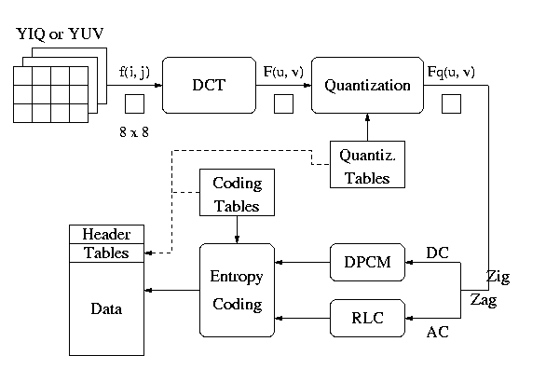
JPEG encoder (sequential)

Slide 40
Sequential mode
Encoder works in YUV color space
Each component is spatially partitioned to blocks of 8x8 pixels.
Block order – left to right, top to bottom.
Resulting bit stream/file have a standard syntax, so that decoders can reproduce the image.

Slide 41
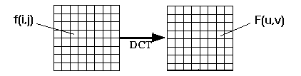
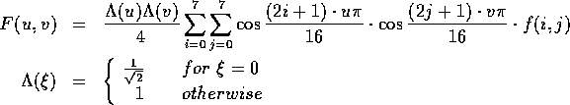
The DCT
Block of 8x8 pixels is transformed into the spatial frequency space.
The Discrete Cosine Transform is used.

Slide 42
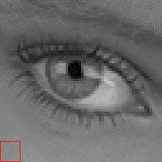


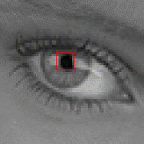


The DCT
The resulting F(u,v) is a block of 8x8 coefficients.
F(0,0) is the DC level of the block, ie. It’s the average over all the pixels of f(i,j).
F(1,0) is the contribution of ½ cycle vertical variation and no horizontal variation.

Slide 43
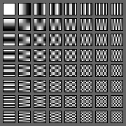
DCT basic vectors
The resulting F(u,v) is a block of 8x8 coefficients.
F(0,0) is the DC level of the block, ie. It’s the average over all the pixels of f(i,j).
F(1,0) is the contribution of ½ cycle vertical variation and no horizontal variation.

Slide 44
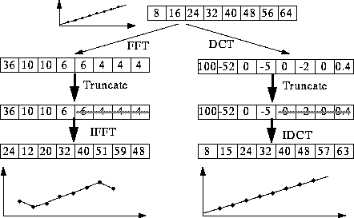
DCT vs FFT
Why DCT not FFT? -- DCT is like FFT, but can approximate linear signals well with few coefficients.

Slide 45
Quantization basics
Why? -- To reduce number of bits per sample F'[u, v] = round ( F[u, v] / q[u, v] ).
Example:
101101 = 45 (6 bits). q[u, v] = 4 ➔ Truncate to 4 bits: 1011 = 11 (eleven).
Quantization error is the main source of the Lossy Compression

Slide 46
Quantization types
Uniform Quantization
Each F[u,v] is divided by the same constant N.
Non-uniform Quantization -- Quantization Tables
Eye is most sensitive to low frequencies (upper left corner), less sensitive to high frequencies (lower right corner)
Quantization Table q(u, v) Luminance Chrominance
----------------------------- ------------------------------
16 11 10 16 24 40 51 61 17 18 24 47 99 99 99 99
12 12 14 19 26 58 60 55 18 21 26 66 99 99 99 99
14 13 16 24 40 57 69 56 24 26 56 99 99 99 99 99
14 17 22 29 51 87 80 62 47 66 99 99 99 99 99 99
18 22 37 56 68 109 103 77 99 99 99 99 99 99 99 99
24 35 55 64 81 104 113 92 99 99 99 99 99 99 99 99
49 64 78 87 103 121 120 101 99 99 99 99 99 99 99 99
72 92 95 98 112 100 103 99 99 99 99 99 99 99 99 99
----------------------------- ------------------------------
The numbers in the above quantization tables can be scaled up (or down) to adjust the so called quality factor
Custom quantization tables can also be put in image/scan header.

Slide 47

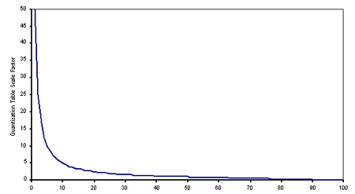

Quality factor
The quantized DCT coefficients are computed by applying the quantization factors, represented as Q, to the DCT coefficients. →
The scale factor, given in this equation is known as the scaling factor and is derived from a quality factor specified by the user. The quality factor is specified on a scale between 0 and 100 where a factor of 100 represents the best image quality (the least quantization).

Slide 48
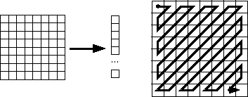
The Zig-Zag scan
Why? -- to group low frequency coefficients in top of vector.
Maps 8 x 8 to a 1 x 64 vector

Slide 49
DC encoding
The first element of the 64 element quantized coefficient is the DC.
DC component is large and varied, but often close to previous value.
Encode the difference from previous 8 x 8 blocks – DPCM (Differential Pulse Code Modulation).

Slide 50
AC encoding
Run Length Encode (RLE) on AC components
1 x 64 vector has lots of zeros in it
Keeps skip and value, where skip is the number of zeros and value is the next non-zero component.
Send (0,0) as end-of-block sentinel value.

Slide 51
RLE example
Consider the following zig-zag vector: (each element is a byte) 1,0,0,0,0,6,7,0,0,0,99,0,0,0→ EOB
The resulting vector will be (0,1) (4,6) (0,7) (3,99) (0,0)
We allow up to 15 repetitions of zeros, so if one have more then 15 it will be splited into more then one elements 1,0….0(17 times),6
Will results : (0,1) (15,0) (1,6) …
EOB symbol

Slide 52
Entropy encoding (Huffman)
Applied to AC coefficients
Starting from the previous run length vector (0,1) (4,6) (0,7) (3,99) (0,0)
Take the quantized DCT coef’ in each pair - (3,99) and find its order (category), ie. The minimum number of bits needed to specify it. For 99 it will be 7 bits.

Slide 53
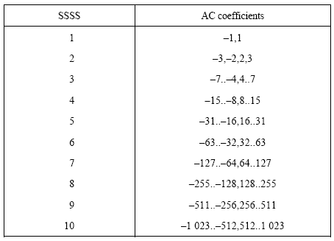
Huffman categories
The following table defines the category.
It is simply finding the bit position of the msb bit in each coef’.

Slide 54
The new run length vector
Now one can construct a triplet vector: (0,1,1) (4,3,6) (0,3,7) (3,7,99) …
Note that DCT coef’ can be negative as well.
The first two fields in each triplet will be coded with 4 bits each.
Note that the second field in the triplet is bounded by 10 decimal (4’ha)
So we have now 16 x 10 possible values for the first two fields.

Slide 55
Huffman tables
Huffman table is a dictionary that assigns a codeword for each of the 160 symbols (in our case).
It can be derived on an image basis, however, this is a long procedure with unclear benefits for our problem.
The standard committee defined this table based on large collection of images.
They are four (4) such table for 8 bits precision. DC/AC luminance/chrominance.

Slide 56
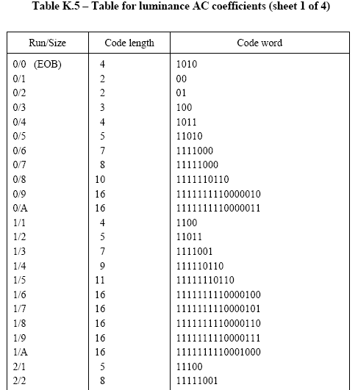
Huffman tables
Note that code words are up to 16 bits length.
This is not a problem since these symbols are rare.

Slide 57
The DCT bit stream
Finally, after applying the Huffman coding the triplet vector will looks like (H(0,1),1) (H(4,3),6) (H(0,3),7) (H(3,7),99) …
The actual DCT value will be appended to each code word, using a length specified in the category table. (H(0,3),7) ➔ 100,011

Slide 58
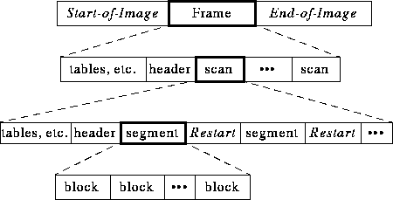
File format / bit stream

Slide 59
Design tradeoff

Slide 60
Imager performance
Since we are dealing with still pictures, we set F – the number of frames per second to 2
Imager shall support pictures of up to 1K pixels in each dimension (x,y)
The maximum pixel rate R will be – 3 x Y x X x F = 6M pixel/sec
This will be the Imager clock
Who will supply the clock ???

Slide 61
Block rate
Assuming R is the pixel rate, so every 64 pixels we accumulates a new block
So the effective block rate B will be R / 64
Note that the block rate per color will be Bc = B / 3
Assuming the encoder work with 50Mhz
then encoder clocks per block is 50M/(R/(64*3)) = 1600 cycles

Slide 62
Block work load (1)
The obvious work per block is the DCT.
Assuming simple approach (no Fast DCT), we have 2 matrix multiplication, each of size 8 x 8
The total operation per block may be: (8 + Delta1) x 64 x 2 = 1024 + 128 x Delta1.
Read / Write load may be 1024 / 128

Slide 63
Block work load (2)
There is more work, we have to quantize the DCT coefficient and to zig-zag.
The two operation can be overlaid ??
The number of operation may be 64 + Delta2 assuming pipelining.
Read/Write will be 64/64

Slide 64
Block work load (3)
Next step will be the run length coding, followed by Huffman
Should we take this procedure along with the previous one ?

Slide 65
RGB -> YCrCb
Where will be the best place/stage to execute this transform ?
Consider memory width …
Consider pipeline complexity ..

Slide 66
Imager –Encoder interface
Imager clock =~ 6Mhz
Encoder clock = 50Mhz
Encoder to supply Imager clock as an integer division of 50Mhz ??
What will be the indication for the encoder to sample a new pixel as the clock rates differs ?

Slide 67
Input stream
[0 → image width -1]
How many blocks we have ?
Pixel cnt
Line cnt % 8
-
-
Buffer fill
-
Input buff (Y)
-
Rgb→ YCrCb
-
Input buff (Cr)
-
-
Input buff (Cb)

Slide 68
Buffer structure
Capacity in pixels – W x 3 x 8 + delta
What is delta ?
W x 3 x 8 → ping-pong
Some other wise arrangement that save memory

Slide 69
Possible Architecture – input stage
x
Input buff_0 (Y)
+
24bit
constants
Input buff_1 (Y)
Line change
Master FSM
When the 3’rd pixel arrives, We have 8 cycles to calculated the transform
Constants for transform from imd (not rom)
Single alu (MAC) for calculating 3 numbers in 8 cycles.
Write the results in 3 b2b cycles to 3 different buffers

Slide 70
Possible Architecture – input stage
x
Input buff_0 (Y)
+
24bit
constants
Input buff_1 (Y)
Line change
Master FSM
Slave work on ..L0
Slave work on ..L1
Y0,Y1,Yn,Cr0,Cr1,Crn..
6 rams, W x 24 bits each, single port, ping pong.
Master machine controls the ram address mux.
When master complete to write a one line of blocks it pulse the line change signal instructing the slave to start reading.
Slave must complete its work before next line change

Slide 71
Possible Architecture – input stage
x
Input buff_0 (Y)
+
24bit
constants
Input buff_1 (Y)
Line change
Input buff_0 (Cr)
Master FSM
Input buff_1 (Cr)
Single machine serve all the rams
Use ram cs to select the ram that gets the write data.
Slave machine does not know where data comes from.
Input buff_0 (Cb)
Input buff_1 (Cb)

Slide 72
Possible Architecture – input stage
x
Input buff_0 (Y)
+
24bit
constants
Input buff_1 (Y)
Line change
Input buff_0 (Cr)
Digits rom
0-9
Input buff_1 (Cr)
date insertion from a rom
each digit is a block 8x8 pixels
to be place in the lower right corner of the picture
10 points in course grade.
Input buff_0 (Cb)
Input buff_1 (Cb)

Slide 73
Possible Architecture – DCT stage
Dct ceoff rom 64 x 24 bits
Block buffer 64 x 24 bits
Input buff_0 (Y)
x
x
+
24bit
Block buffer 64 x 24 bits
+
24bit
Input buff_1 (Y)

Slide 74
Micro - scheduling

Slide 75
JPEG encoder (sequential)

Slide 76
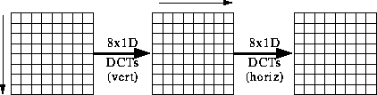
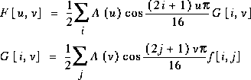
The Fast DCT

Slide 77
